Slide 1
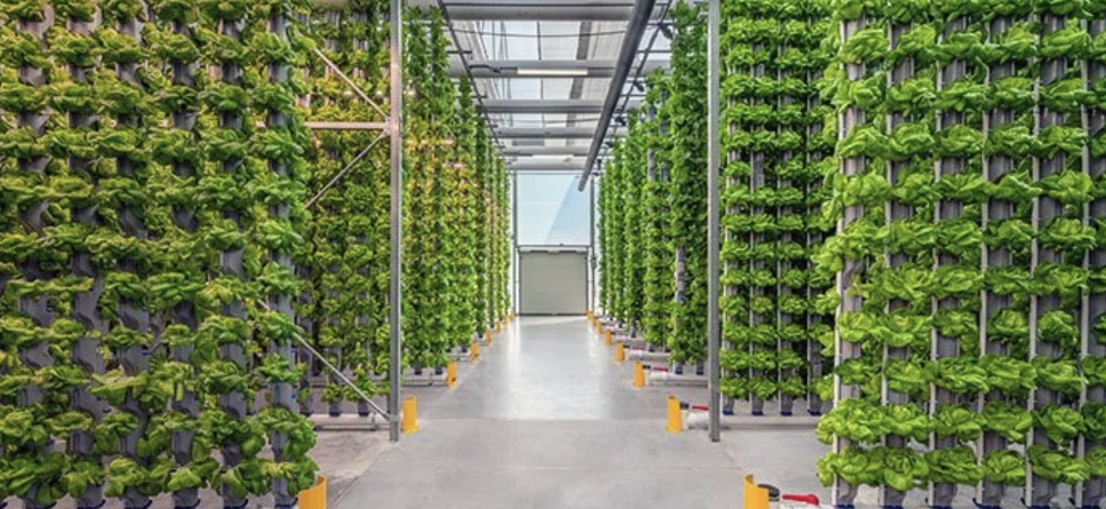
AI Systems – Individual Study
Optimizing Hydroponic Farming with AI & IoT
Student: Lindsay Cooper
Minor Program: AI Systems

Slide 2
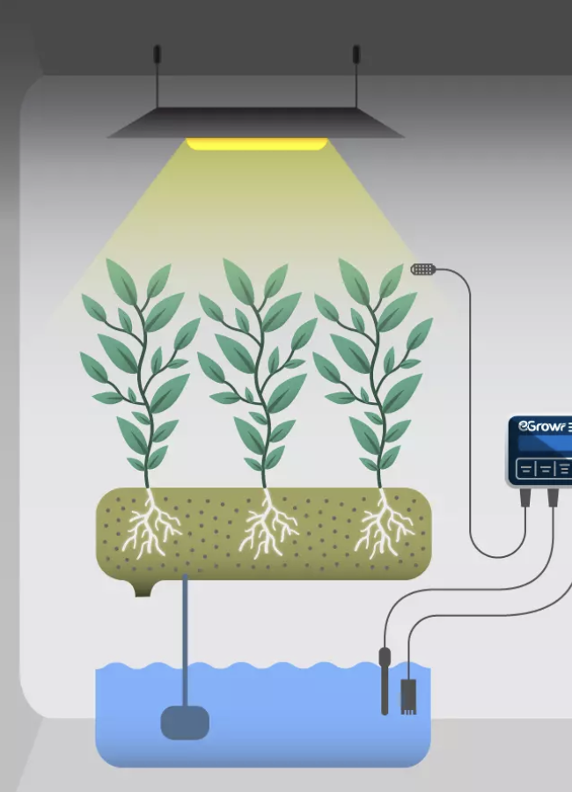
Objective & Focus
Objective:
To design and develop an intelligent IoT-based system that uses AI and sensors to monitor and optimize water quality in hydroponic farming for sustainable agriculture.
Focus:
Monitor water parameters (EC, pH, temperature, dissolved oxygen).
Use predictive analytics for optimization.
Evaluate financial, ecological, and technical impact.
Main Question:
How can AI be applied to optimize hydroponic farming by combining IoT-based monitoring of water parameters with predictive analytics for sustainable resource management?

Slide 3

Learning Goals
Technical Goals:
Integrate AI with IoT for real-time monitoring.
Build predictive analytics for water-quality forecasting.
Design a scalable system architecture.
Personal Goals:
Strengthen skills in Python, AI frameworks, and architecture design.
Improve project management and communication.
Bridge software engineering and sustainability applications.

Slide 4
Research Development
Conducted Research on hydroponics, IoT applications, AI.
Identified critical water parameters: EC, pH, temperature, oxygen.
Identify potential sensors
Explored open-source frameworks: TensorFlow Lite, scikit-learn, Edge Impulse.
Purchase order was <=140 euros.

Slide 5
System Overview
Sensors: pH, EC, Temperature, DO, ORP
Dissolved Oxygen was not developed in prototype because of cost.
ESP32 microcontroller
MQTT + QuestDB pipeline
AI models for predicting action on nutrient or pH dosing advice
Web dashboard (Next.js)

Slide 6
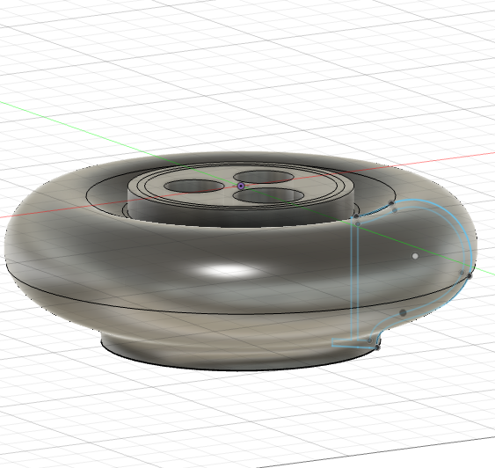
Floatable Prototype
Custom floating probe holder (3D printed)
Designed for long-term water exposure
Supports multiple probes simultaneously
Probes are held in a core sleave for ease of removal

Slide 7
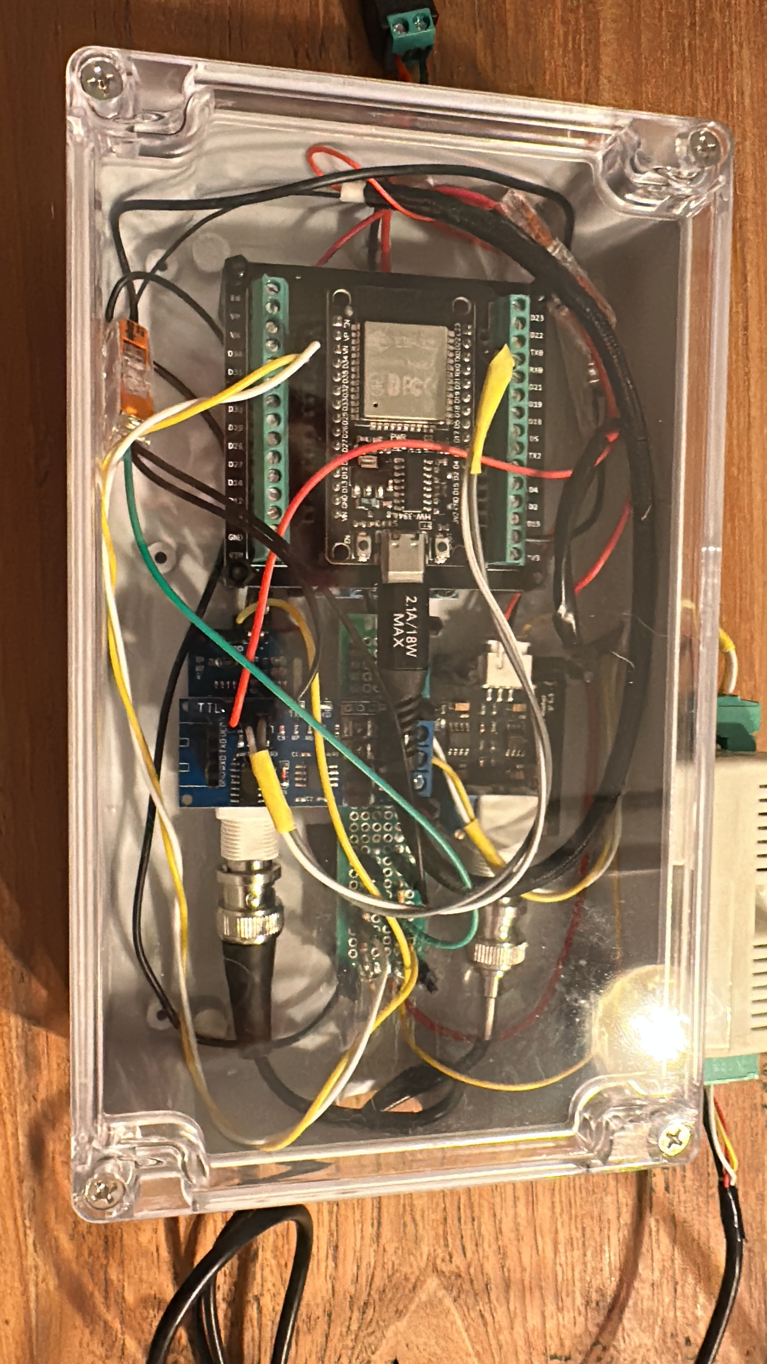
Electrical Principles in IoT
Understanding the components
Breadboard prototyping
Initial wiring
Box mounting.

Slide 8
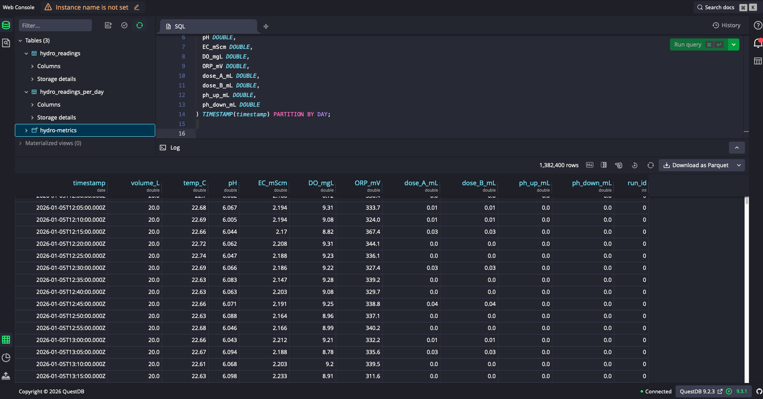
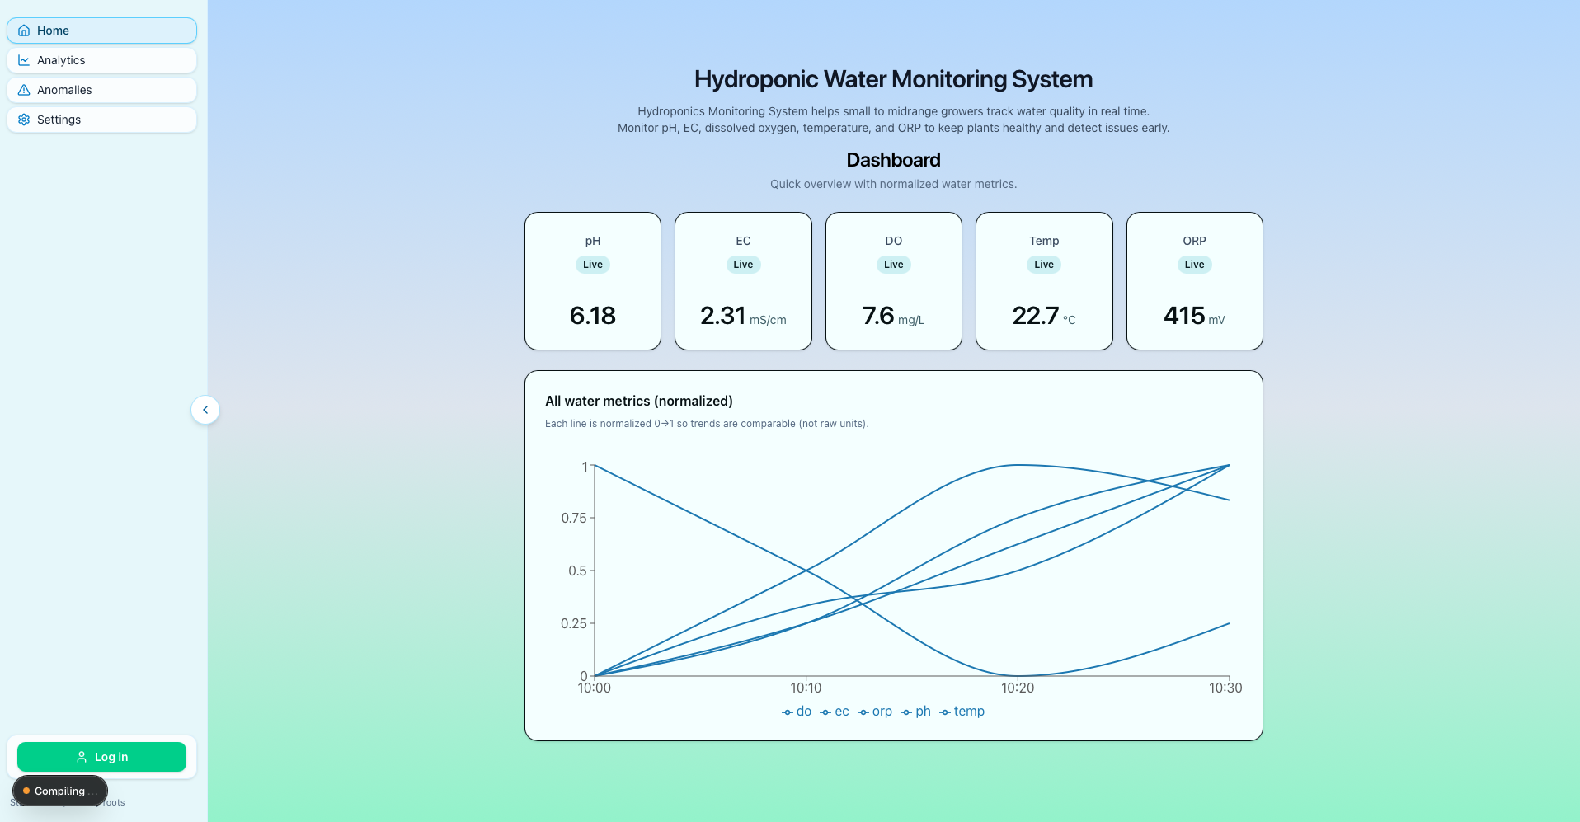
Frontend/ Backend
Backend is built within the Next.js project. Connected and utilized through Python script.
Frontend is built from Next.js, TailwindCss,

Slide 9
Data Pipeline
Sensors → ESP32 → MQTT → QuestDB
→ Feature Engineering → AI Models → Dashboard

Slide 10
Machine Learning Approach
Supervised learning
Inputs (features): current reservoir state (pH, EC, DO, ORP, temp, volume) + time features + short-term trends (deltas) + smoothed values (EMA)
Outputs (targets): how much to dose A, B, pH up, pH down (in mL)
Multi-output regression (XGBoost)
Predicts nutrient & pH dosing actions
Trained on synthetic water metrics runs

Slide 11
Feature Engineering
Raw sensor values
Time features (day of the week, hour)
Deltas & EMAs for trends
Run-based split to prevent leakage

Slide 12
Evaluation
• MAE & R² metrics
• Run-based validation
• Comparison vs manual dosing

Slide 13
Sustainability Impact
Improve resource management
Earlier anomaly detection
Potentially optimize water & nutrient delivery systems

Slide 14
Challenges & Risks
Sensor drift & calibration
Noisy real-world data
Limited labeled anomalies

Slide 15
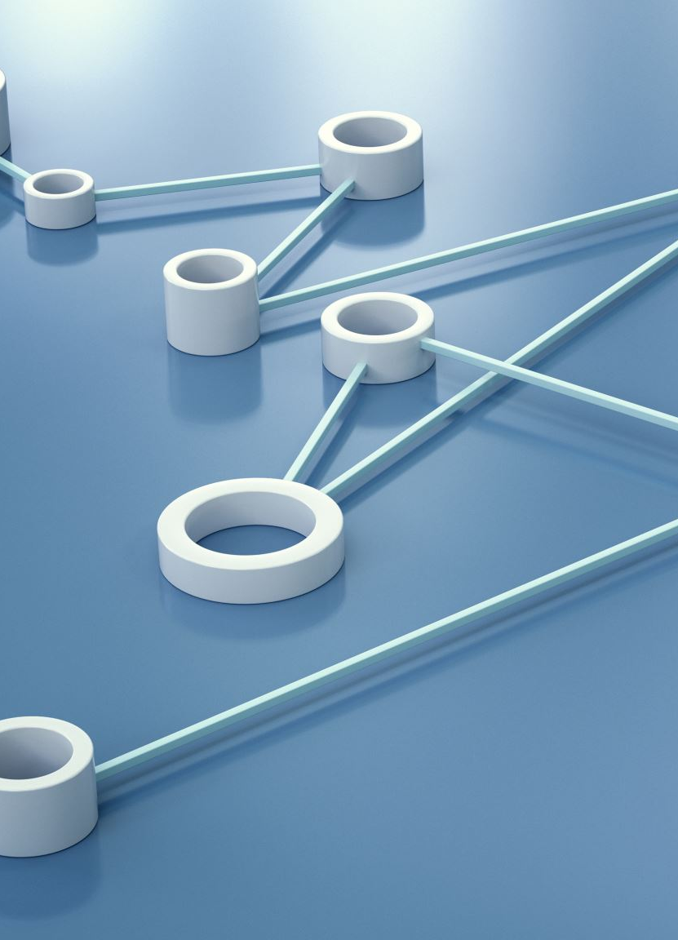
Learning Outcomes
End-to-end AI system design
IoT + ML integration
Research & methodology skills
Professional reflection & feedback

Slide 16
Future Work
Closed-loop control (human-in-the-loop)
Edge inference with TensorFlow Lite
More sensors & longer trials

Slide 17
Conclusion
AI-enabled hydroponics can improve the usage of water and nutrient.
Possibly mitigate risks associated with too much pH, nutrient, or poor microbiome through active monitoring insights.
sustainability, efficiency, and decision-making in controlled agriculture.

